Slide 1
Secured-T
Group members:
RADIN AYUWANDIRA BINTE RADIN AMIRMUMININ
LIM XIN LI
BAVANI D/O RAMAN
T.PUVARNESWAREN RAJA
Sponsor: DMIT
Supervisor: Karl Kwan

Slide 2
Table of Content
Background
Objectives
Solutions
Deliverables

Slide 3



Background
Written examinations
are inappropriate to assess
technical modules
Notes:
In most educational institutions, the examinations are conducted as written papers each year. However, for technical related modules such as programming (as in EAD, PSE, WCD, JAVA) where it requires students to code, it is less appropriate to assess them in written format.
Examinations. One of a student’s nightmares. It assesses our ability to remember facts and our understanding in the particular subject. However,
Writing: http://yenikutahya.com/wp-content/uploads/2015/11/M%C4%B0SAF%C4%B0R-KALEM-KARE.png
Thumbs down: https://healthycities.zendesk.com/hc/en-us/article_attachments/209680108/Thumbs_down_icon_-_500px.png
Man with laptop is linked in slide 6
Background should have some problems??
Some modules are practical oriented, but during exam is written, that is very wrong

Slide 4





Student’s POV
Unfamiliar
Unfair
Unfavourable
Notes:
As a student who has done written technical modules, I find it to be
Unfamiliar
All these while, I have been doing all my practicals and assignments on my laptop and having to switch to written test form makes me feel unaccustomed to the change
Unfair
I feel that it tests on my memory instead of my capabilities since I would have to memorise all the little things that would have been corrected by the software and thus, not getting the score I deserved
Last but not least, it is unfavourable to me if the exam is open book
I would have to buy and bring the hard-copied resources
However with online assessments I could access information on the internet or the notes on my laptop
makes it more convenient and time-saving
Computer: https://img.clipartfest.com/e57daaf44a21e6679d873338d7937805_computer-monitor-and-keyboard-computer-screen-clipart-black-and-white_2400-1879.png
Arrow clipart: https://apoya.ateistaspr.org/wp-content/uploads/2015/05/arrow-55-xxl.png
Written paper:
https://cdn1.iconfinder.com/data/icons/communication-social-media-set-2/512/3-128.png
???: http://clipart-library.com/data_images/81928.png
Books clipart: http://www.clipartkid.com/images/768/book-blank-card-clipart-cliparthut-free-clipart-hKi38J-clipart.jpg

Slide 5

Online Assessments
Notes:
Therefore, as a student, I want to be able to do online assessments for technical modules so that I can be assessed more accurately.
Lecturer: However, as a lecturer, allowing students to use their notebook for the examination lead to problems as a result.
Image 1:
https://www.passged.com/files/icons/computer-skill.png

Slide 6



Lecturer’s POV
Challenging
Notes:
Lecturer: However, as a lecturer, allowing students to use their notebook for the examination lead to problems as a result.
Challenging
To monitor all students at the same time
When students aren't being monitored
It become Easy for the students to cheat
Communicate with fellow mates to share answer
Not only that previously during online examination Lecturers have experienced cases like students sharing answers by - Cross-talking or through social media, forums, SSH, FTP, and so on
Teacher: https://cdn.pixabay.com/photo/2016/03/31/15/18/teacher-1293148_1280.png
Eye: http://cliparting.com/wp-content/uploads/2016/06/Eyeball-eye-clip-art-clipart-cliparts-for-you-image.png
Red no circle: http://www.clker.com/cliparts/6/S/W/2/g/t/transparent-red-no-circle.svg
Man with laptop: https://image.flaticon.com/icons/png/512/46/46467.png

Slide 7

Controlled Environment
Notes:
http://www.clker.com/cliparts/O/7/n/r/k/w/hotel-icon-has-internet-in-room-hi.png
Therefore, As a lecturer, I want a controlled environment for online examinations so that I can remotely monitor and limit access to websites in order to prevent students from cheating.

Slide 8



Objectives
While preventing students from cheating by:
Allow online assessments to be conducted on the student’s personal notebook
Notes:
Crosstalk1: https://festagent.com/system/festivals/logos/000/001/098/medium/Crosstalk.png?1456773573
Crosstalk: http://images.clipartpanda.com/crosstalk-clipart-ncELpM7cA.jpeg
Laptop: https://img.clipartfest.com/0d949dc4cb797f4b9b6122bd648b097e_free-laptop-clipart-pictures-laptop-clipart-black-and-white_2400-2400.png
Eye: https://img.clipartfest.com/fd3dcecf7b8f8220d8774862f5a277f9_-download-clip-art-free-big-eyes-clip-art_800-800.png
Website: https://blog.wellandcreative.com/wp-content/uploads/2017/05/https-secured-website.png
By:
Monitoring the students remotely
Allowing access to only accepted websites thus preventing students from accessing other websites

Slide 9
Solutions
to prevent students from cheating

Slide 10


Existing Solutions
LanSchool Classroom Management Software
Firewall
Notes:
LanSchool: http://www.joyinourjourney.com/uploads/4/2/4/8/4248738/7434686.png?480 Firewall: http://www.cbronline.com/wp-content/uploads/2016/05/firewall.jpg
LanSchool Classroom Management Software (used in EHD class environment which is downloaded on every school pc)
Monitor, Communicate, Blank student screen, Limit access to specific websites
Software needs to be downloaded on every student's’ laptop which causes It to be inconvenient, pose as a risk if the students do not have the software installed on the day of the examination. It is not recorded in database as well and lastly its very costly
Firewall
Set firewall rules
Tedious and impractical

Slide 11
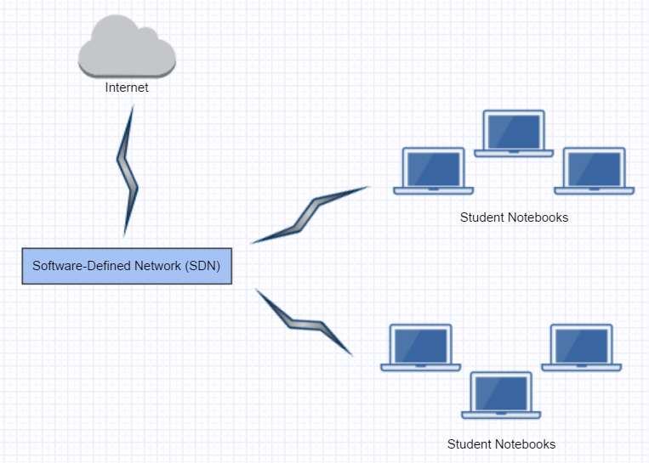
Network Environment
Notes:
Before we move on to the possible solutions, we will give a brief explanation on our network environment
Students will be connected to this software defined network so that all connection to internet must go through a secured network. Within this network, we will be monitoring and controlling the student’s activities .Following are some of the possible solutions we could add to our system.

Slide 12




Possible Solutions
Screen Capture
Heartbeat Program
Logging
Port Scanning
Notes:
1st image: https://d30y9cdsu7xlg0.cloudfront.net/png/18877-200.png
2nd image: https://d30y9cdsu7xlg0.cloudfront.net/png/154534-200.png
3rd image: https://cdn0.iconfinder.com/data/icons/cosmo-documents/40/log-128.png
4th image: http://www.iconshock.com/img_jpg/STROKE/security/jpg/128/scan_port_icon.jpg
Screen Capture
Take picture of screen to get an idea of what the student is doing
Heartbeat Program (constantly connected to our network)
It shows Alive when the student’s are connected to our network, shows dead when they are disconnected from the network
Logging (Key-logging)
To capture all the activities the students are doing on their notebook in real time
Port Scanning
Determine if there are any ports such as ssh and ftp being active on a student’s laptop which they can make use of to cheat

Slide 13
What we promise to deliver
Notes:
We wish to fulfill the needs of both the student and the lecturer.
We would like to provide a controlled environment for online testing with our system, Secured-T

Slide 14
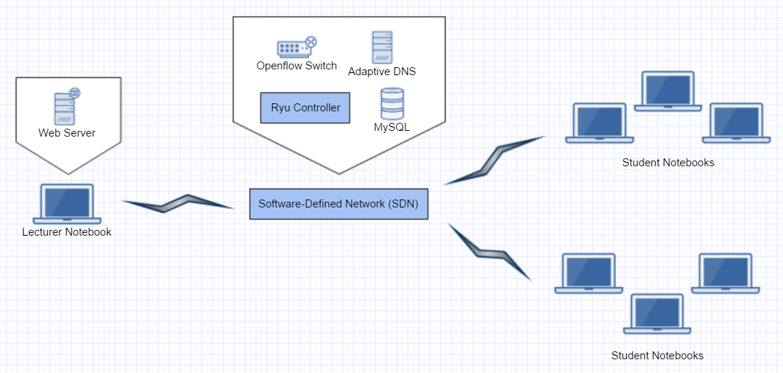

Notes:
Adaptive DNS -> reference from previous project Router change to SDN (include Openflow switch, mininet, ryu controller, MySQL) Lecturer Workstation (Apache Web Server)
IN CONCLUSION:
Imagine we are conducting an online assessment, this is how it would look like.
the students will be connecting to the SDN which comprises of:
On the other end, the lecturer’s notebook will also be connecting to the SDN and will contain the website that allows them to control the network and monitor the students remotely while our system helps to cancel out any plausible cross-talking.
And that is how it works
Ofc, this does not eliminate the need to invigilate the classroom environment.

Slide 15
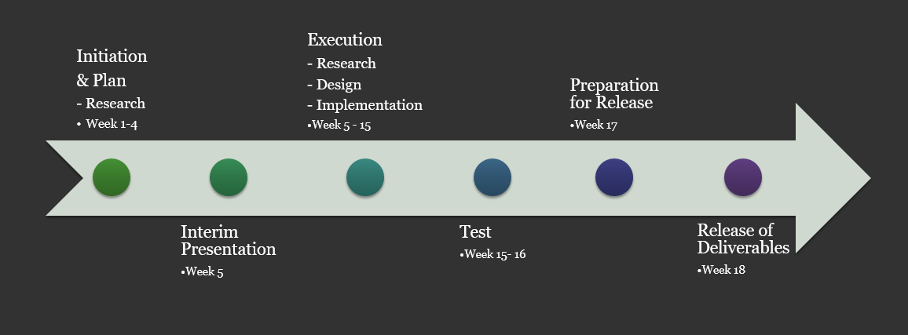
Timeline

Slide 16
Q & A
Notes:
OAS → Online Assessment System
Qns:
Why did you all name it as Secured-T? What does it even mean?
Secured is in itself, its own meaning. A controlled and protected. T stands for testing. SeT
When?
Hopefully by week 18
Will there be any problem when using this Secured OAS?
Risk Analysis
What does Ryu Controller do?
What does Mininet do?
What does OVS do?
What does DNS do?
Why do you need a router?
Apart from the possible solution is there any other ways to secure OAS?
LANSchool vs Secured-T
Requires minimum setup
Notebook
Router

Slide 17
References
Anon, (n.d.). [image] Available at: http://yenikutahya.com/wp-content/uploads/2015/11/M%C4%B0SAF%C4%B0R-KALEM-KARE.png [Accessed 16 May 2017].
Thumbs Down. (n.d). [image] Available at: https://healthycities.zendesk.com/hc/en-us/article_attachments/209680108/Thumbs_down_icon_-_500px.png [Accessed 16 May 2017].
Computer Monitor & Keyboard Computer Screen. (n.d.). [image] Available at: https://img.clipartfest.com/e57daaf44a21e6679d873338d7937805_computer-monitor-and-keyboard-computer-screen-clipart-black-and-white_2400-1879.png [Accessed 16 May 2017].
Arrow. (n.d.). [image] Available at: https://apoya.ateistaspr.org/wp-content/uploads/2015/05/arrow-55-xxl.png [Accessed 16 May 2017].
Anon, (n.d.). [image] Available at: https://cdn1.iconfinder.com/data/icons/communication-social-media-set-2/512/3-128.png [Accessed 16 May 2017].
Anon, (n.d.). [image] Available at: http://clipart-library.com/data_images/81928.png [Accessed 16 May 2017].
Anon, (n.d.). [image] Available at: http://www.clipartkid.com/images/768/book-blank-card-clipart-cliparthut-free-clipart-hKi38J-clipart.jpg [Accessed 16 May 2017].
Computer Skills. (n.d.). [image] Available at: https://www.passged.com/files/icons/computer-skill.png [Accessed 16 May 2017].
Teacher. (2017). [image] Available at: https://cdn.pixabay.com/photo/2016/03/31/15/18/teacher-1293148_1280.png [Accessed 16 May 2017].
Eye Ball. (n.d.). [image] Available at: http://cliparting.com/wp-content/uploads/2016/06/Eyeball-eye-clip-art-clipart-cliparts-for-you-image.png [Accessed 16 May 2017].
Scan Port. (n.d.). [image] Available at: http://www.iconshock.com/img_jpg/STROKE/security/jpg/128/scan_port_icon.jpg [Accessed 9 May 2017]
Risk Analysis. (2017). [image] Available at: http://www.ies-resilience.co.uk/images/tab_images/grid.png [Accessed 9 May 2017].
Anon, (n.d.). [image] Available at: http://www.clker.com/cliparts/O/7/n/r/k/w/hotel-icon-has-internet-in-room-hi.png [Accessed 16 May 2017].
Anon, (n.d.). [image] Available at: https://d30y9cdsu7xlg0.cloudfront.net/png/18877-200.png [Accessed 9 May 2017].
Anon, (n.d.). [image] Available at: https://d30y9cdsu7xlg0.cloudfront.net/png/154534-200.png [Accessed 9 May 2017].

Slide 18
References
Red No Circle. (n.d.). [image] Available at: http://www.clker.com/cliparts/6/S/W/2/g/t/transparent-red-no-circle.svg [Accessed 9 May 2017].
Anon, (n.d.). [image] Available at: https://image.flaticon.com/icons/png/512/46/46467.png [Accessed 16 May 2017].
Anon, (n.d.). [image] Available at: https://img.clipartfest.com/fd3dcecf7b8f8220d8774862f5a277f9_-download-clip-art-free-big-eyes-clip-art_800-800.png [Accessed 16 May 2017].
Firewall. (n.d.). [image] Available at: http://www.cbronline.com/wp-content/uploads/2016/05/firewall.jpg [Accessed 16 May 2017].
LanSchool. (2017). [image] Available at: http://www.joyinourjourney.com/uploads/4/2/4/8/4248738/7434686.png?480 [Accessed 16 May 2017].
Laptop. (n.d.). [image] Available at: https://img.clipartfest.com/0d949dc4cb797f4b9b6122bd648b097e_free-laptop-clipart-pictures-laptop-clipart-black-and-white_2400-2400.png [Accessed 16 May 2017].
Secured Website. (n.d.). [image] Available at: https://blog.wellandcreative.com/wp-content/uploads/2017/05/https-secured-website.png [Accessed 16 May 2017].
Cosmo Documents. (n.d.). [image] Available at: https://cdn0.iconfinder.com/data/icons/cosmo-documents/40/log-128.png [Accessed 9 May 2017].

Slide 19
THE END

